Slide 1
CI7870 Interim slide deck structure
2019

Slide 2
structure
Title slide
Description, premise, setting, world, location
Context, story intro, if narrative otherwise not
Characters; hero's and enemies
Mechanic
Progression, wins, rewards, collectibles, etc
Interior economy
Monetisation economy

Slide 3
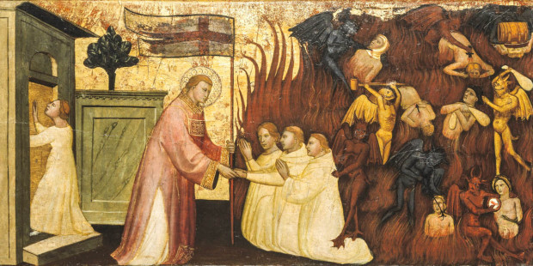
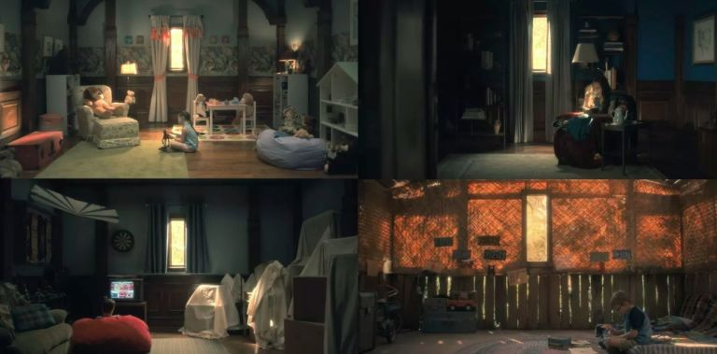
GAME WORLD
Purgatory
Souls
Angels & Demons
Decay/Soulless
Deified/Demonised
Past/Present
Notes:
Purgatory Waiting room where souls are purified from their sins
Can see and feel the holy heaven and the fiery hell
God and Devil is absent
Environment gets affected by nearby souls
No time and space in the purgatory
Souls and environment decay overtime

Slide 4
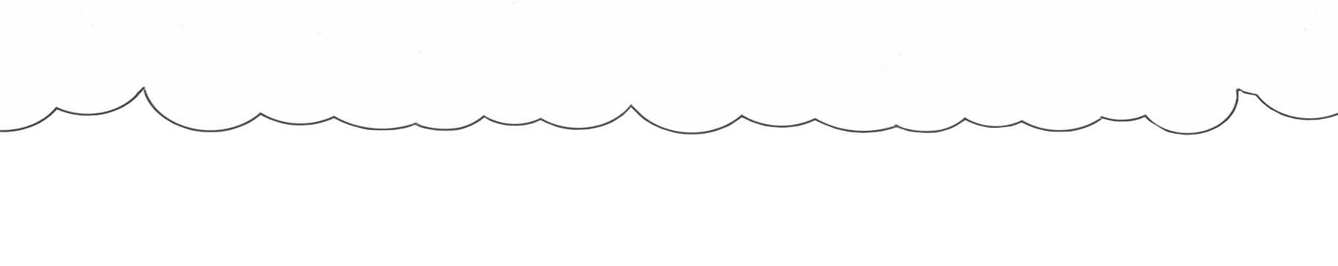









Super Gardeners
The Game Mechanic
Horticulture:
Water Plant Pot > Flower Shoot
Flower Shoot > Plant it where Grow-light is shining
Grow-light > Turns Flower Shoot to a full grown Flower
Flower > Deposited in Crate

